Slide 1
Advanced Data types and Sorting
Session 11

Slide 2
Objectives - 1
Explain structures and their use
Define structures
Declare structure variables
Explain how structure elements are accessed
Explain how structures are initialized
Explain how assignment statements are used with structures
Explain how structures can be passed as arguments to functions
Use arrays of structures
Explain the initialization of structure arrays

Slide 3
Objectives - 2
Explain pointers to structures
Explain how structure pointers can be passed as arguments to functions
Explain the typedef keyword
Explain array sorting with the Selection sort and Bubble sort methods

Slide 4
Structures
A structure consists of a number of data items, which need not be of the same data type, grouped together
The structure could hold as many of these items as desired
}
1
I
I
L
L
U
S
I
O
N
B
A
C
H
1
}
Variable
L
L
U
Name of the book
Author
Edition
S
I
Structure
O
N
Array

Slide 5
Defining a Structure
A structure definition forms a template for creating structure variables
The variables in the structure are called structure elements or structure members
Example:
  struct cat
  { char bk_name [25];
  char author [20];
  int edn;
  float price;
  };

Slide 6
Declaring Structure Variables
Once the structure has been defined, one or more variables of that type can be declared
Example: struct cat books1;
The statement sets aside enough memory to hold all items in the structure
Other ways
struct cat { char bk_name[25];
char author[20];
int edn;
float price;
} books1, books2;
struct cat books1, books2;
or
struct cat books1;
struct cat books2;

Slide 7
Accessing Structure Elements
Structure elements are referenced through the use of the dot operator (.), also known as the membership operator
Syntax:
structure_name.element_name
Example:
scanf(“%s”, books1.bk_name);

Slide 8
Initializing Structures
Like variables and arrays, structure variables can be initialized at the point of declaration
  struct employee
  { int no;
  char name [20];
  };
Variables emp1 and emp2 of the type employee can be declared and initialized as:
struct employee emp1 = {346, “Abraham”};
struct employee emp2 = {347, “John”};

Slide 9
Assignment Statements Used
with Structures-1
It is possible to assign the values of one structure variable to another variable of the same type using a simple assignment statement
For example, if books 1 and books2 are structure variables of the same type, the following statement is valid
books2 = books1;

Slide 10
Assignment Statements Used
with Structures - 2
In cases where direct assignment is not possible, the in-built function memcpy() can be used
Syntax:
memcpy (char * destn, char &source, int nbytes);
Example:
memcpy (&books2, &books1, sizeof(struct cat));

Slide 11
Structures within Structures
It is possible to have one structure within another structure. A structure cannot be nested within itself
struct issue
{
char borrower [20];
char dt_of_issue[8];
struct cat books;
}issl;
To access the elements of the structure the format will be similar to the one used with normal structures,
issl.borrower
To access elements of the structure cat, which is a part of another structure issue,
issl.books.author

Slide 12
Passing Structures as
Arguments
A structure variable can be passed as an argument to a function
This facility is used to pass groups of logically related data items together instead of passing them one by one
The type of the argument should match the type of the parameter

Slide 13
Array of Structures
A common use of structures is in arrays of structures
A structure is first defined, and then an array variable of that type is declared
Example:
struct cat books[50];
To the access the variable author of the fourth element of the array books:
books[4].author

Slide 14
Initialization of Structure
Arrays
Structure arrays are initialized by enclosing the list of values of its elements within a pair of braces
Example:
struct unit
{ char ch;
int i;
};
struct unit series [3] =
{ {‘a’, 100}
{‘b’, 200}
{‘c’, 300}
};

Slide 15
Pointers to Structures
Structure pointers are declared by placing an asterisk(*) in front of the structure variable’s name
The -> operator is used to access the elements of a structure using a pointer
Example:
struct cat *ptr_bk;
ptr_bk = &books;
printf(“%s”, ptr_bk->author);
Structure pointers passed as arguments to functions enable the function to modify the structure elements directly

Slide 16
The typedef keyword
A new data type name can be defined by using the keyword typedef
It does not create a new data type, but defines a new name for an existing type
Syntax:
typedef type name;
Example:
typedef float deci;
typedef cannot be used with storage classes

Slide 17
Sorting Arrays
Sorting involves arranging the array data in a specified order such as ascending or descending
Data in an array is easier to search when the array is sorted
There are two methods to sort arrays – Selection Sort and Bubble Sort
In the selection sort method, the value present in each element is compared with the subsequent elements in the array to obtain the least/greatest value
In bubble sort method, the comparisons begin from the bottom-most element and the smaller element bubbles up to the top

Slide 18
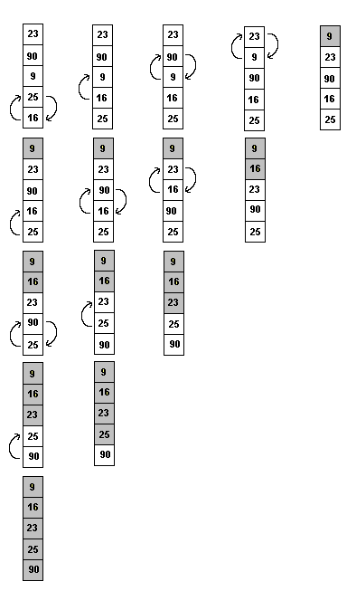
Bubble Sort-1

Slide 19
Bubble Sort-2
#include <stdio.h>
void main()
{
int i, j, temp, arr_num[5] = { 23, 90, 9, 25, 16};
clrscr();
for(i=3;i>=0;i--) /* Tracks every pass */
for(j=4;j>=4-i;j--) /* Compares elements */
{ if(arr_num[j]<arr_num[j-1])
{ temp=arr_num[j];
arr_num[j]=arr_num[j-1];
arr_num[j-1]=temp;
}
} Contd…..
Example

Slide 20
Bubble Sort-3
printf("\nThe sorted array");
for(i=0;i<5;i++)
printf("\n%d", arr_num[i]);
getch();
}
Example

Slide 21
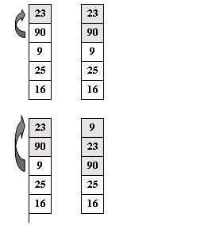
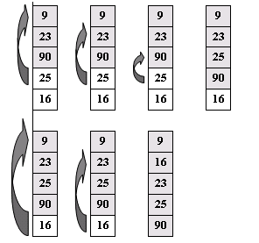
Insertion Sort-1

Slide 22
Insertion Sort-2
#include<stdio.h>
void main()
{
int i, j, arr[5] = { 23, 90, 9, 25, 16 };
char flag;
clrscr();
/*Loop to compare each element of the unsorted part of the array*/
for(i=1; i<5; i++)
/*Loop for each element in the sorted part of the array*/
for(j=0, flag='n'; j<i && flag=='n'; j++)
{
if(arr[j]>arr[i])
{ /*Invoke the function to insert the number*/
insertnum(arr, i, j);
flag='y';
}
}
printf("\n\nThe sorted array\n");
for(i=0; i<5; i++)
printf("%d\t", arr[i]);
getch();
}

Slide 23
Insertion Sort-3
insertnum(int arrnum[], int x, int y)
{
int temp;
/*Store the number to be inserted*/
temp=arrnum[x];
/*Loop to push the sorted part of the array down from the position where the number has to inserted*/
for(;x>y; x--)
arrnum[x]=arrnum[x-1];
/*Insert the number*/
arrnum[x]=temp;
}

